Slide 1
The Best Neighborhood in Pittsburgh
By Kevin Burkhardt, Heather Diegert, Aidan Kennedy

Slide 2
Metric Explanation
Arrest data
Parks
Blood-lead level content

Slide 3
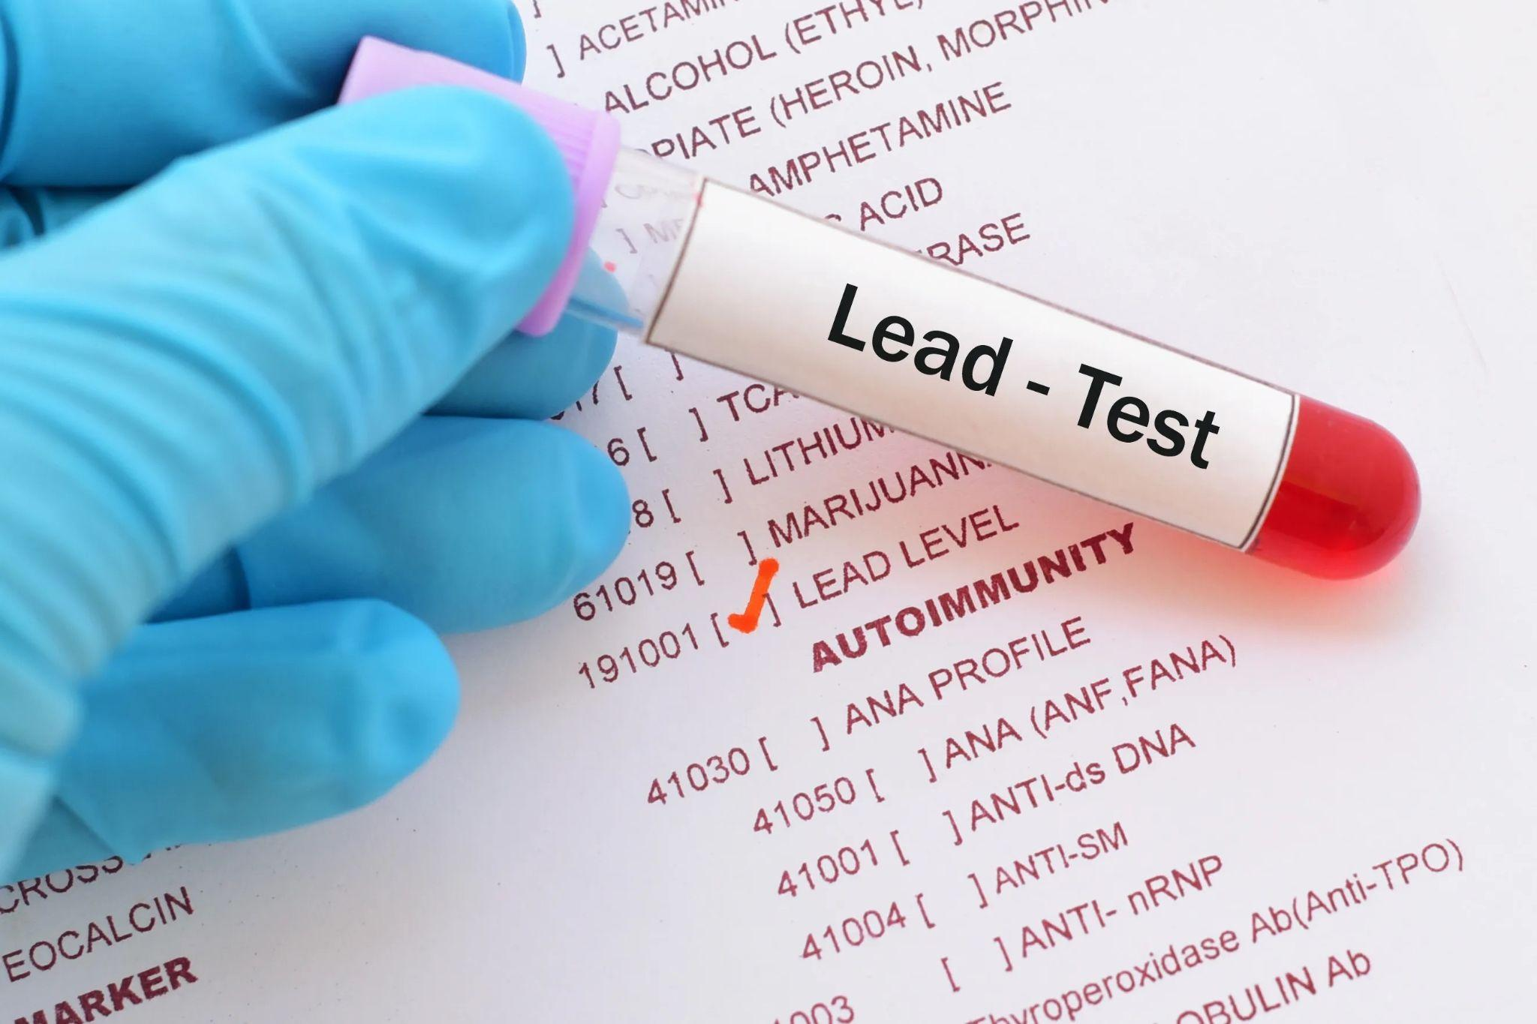
Blood Lead Levels
Refers to a higher-than-normal concentration of lead in the bloodstream
May damage brain and nervous system, leading to developmental delays, lower IQ, and behavioral problems in children
May cause anemia and damage to the kidneys and other organs in both children and adults
https://github.com/kevinburkhardt/Big_Ideas_Final/blob/main/Apk82-Final-Project-Notebook.ipynb

Slide 4
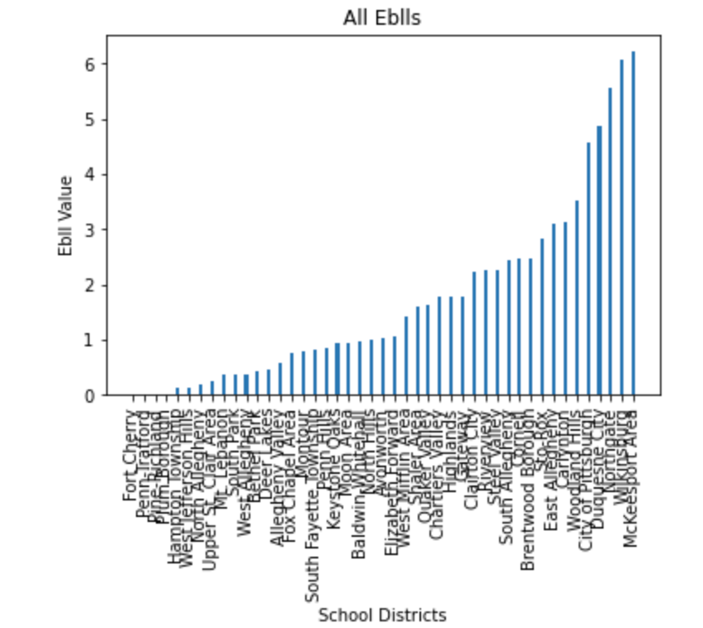
Blood Lead Levels
Pittsburgh School Districts 2015-2020 EBLL
Lowest:
Mcdonald (Fort Cherry)
Harrison City (Penn-Trafford)
Gibsonia (Pine-Richland)
Plum (Plum Borough)
Allison Park (Hampton Township)
Jefferson Hills (West Jefferson Hills)

Slide 5
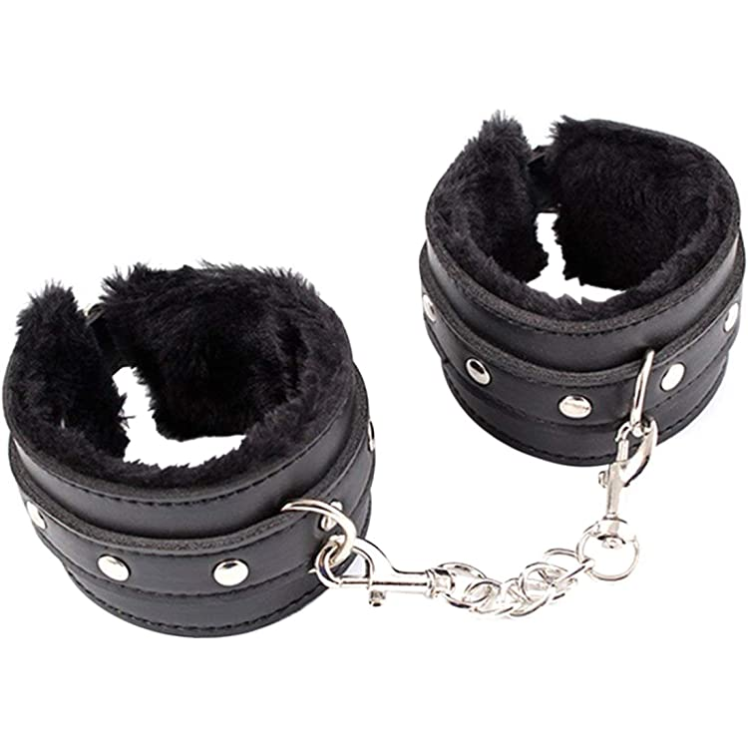
Arrest Data
Arrest data will show the safety of each neighborhood in Pittsburgh
The more arrests that there are, the more crime… obviously
The less crime, the safer the neighborhood
I mean this is pretty self explanatory

Slide 6
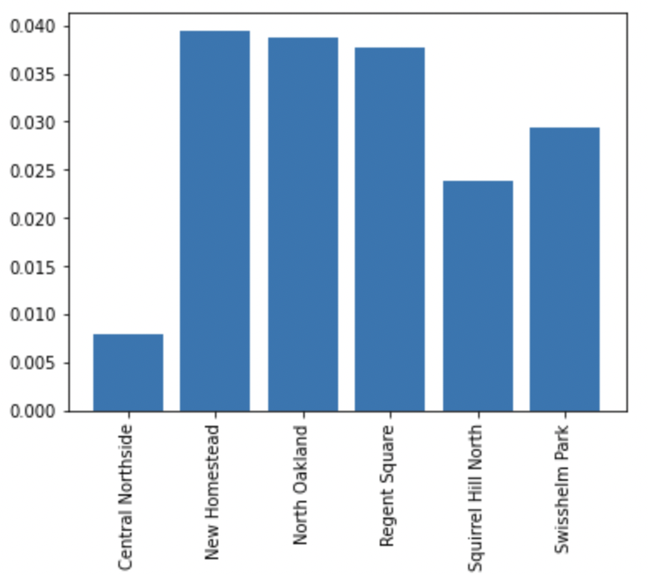
Arrest Data
I took arrest data for each neighborhood, then I gathered census data. I then took the ratio of number of arrests to population to determine which neighborhoods had the lowest rate.
https://github.com/kevinburkhardt/Big_Ideas_Final/blob/main/kcb47.ipynb

Slide 7
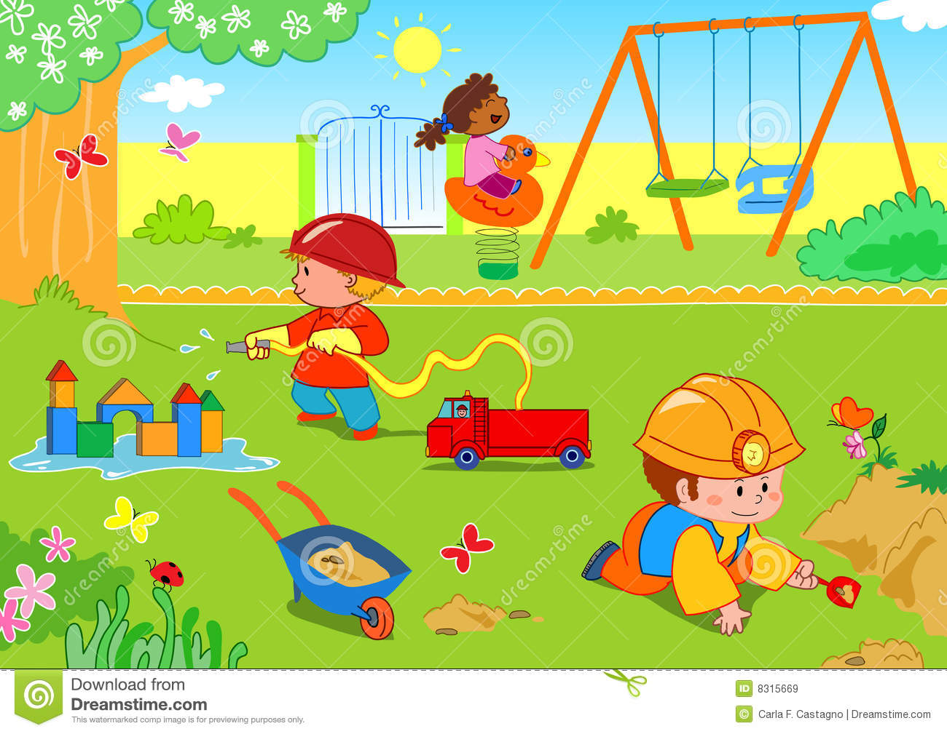
Parks In Pittsburgh
The number of parks in the neighborhood can be an indicator of how safe it is. For example, we can assume that more parks/community spaces will be built in safer neighborhoods. On the other hand, in less pleasant parts of the city, there will be fewer parks. There could show that the neighborhood is less community-oriented, hence why less community space, like a park, is present.

Slide 8
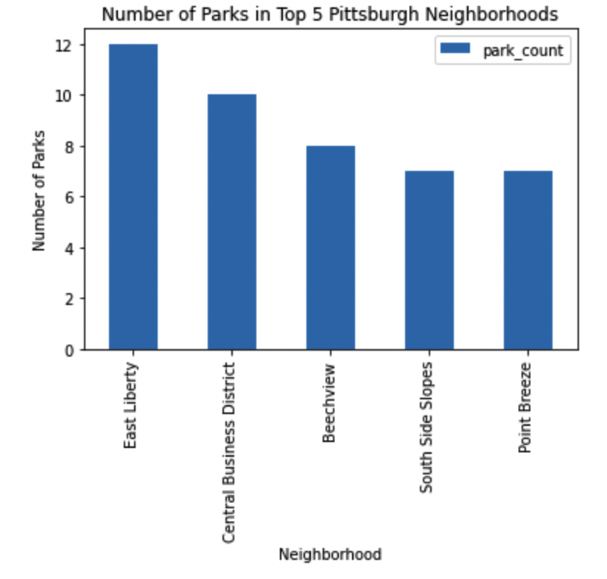
CSV Data
The data from the CSV was collected and sorted based on the number of parks located in a neighborhood. The top five neighborhoods with the most parks are shown in the graph.
https://github.com/kevinburkhardt/Big_Ideas_Final/blob/main/had78.ipynb

Slide 9
The Best Neighborhood
Arrest:
Central Northside
Squirrel Hill North
Swisshelm Park
Regent Square
North Oakland
Parks:
East Liberty
Central Business
Beechview
South Side Slopes
Point Breeze
Blood-Lead Levels:
Mcdonald
Harrison City
Gibsonia
Plum
Allison Park
Overall Winner:
✰ ??? ✰
Inconclusive

